Slide 1

LCC 401 TOPIC, STATED MAIN IDEA AND IMPLIED MAIN IDEA
Wan Najmiyyah Wan Md Adnan
Academy of Language Studies,
UiTM Terengganu.

Slide 2
Learning Outcomes
Identify the topic of a paragraph
Identify the stated main idea of a paragraph
FORMULATE the implied main idea of a paragraph

Slide 3
Introduction
Identifying the topic helps readers to understand what the paragraph is all about.
After identifying the topic, readers should be able to locate the author’s main idea in each paragraph of the text.

Slide 4
Stated and Implied Main Ideas
The stated main idea, which is written in a sentence, is the most important point of the topic
The implied main idea is not clearly or directly stated in any one sentence in the paragraph.

Slide 5


Slide 6
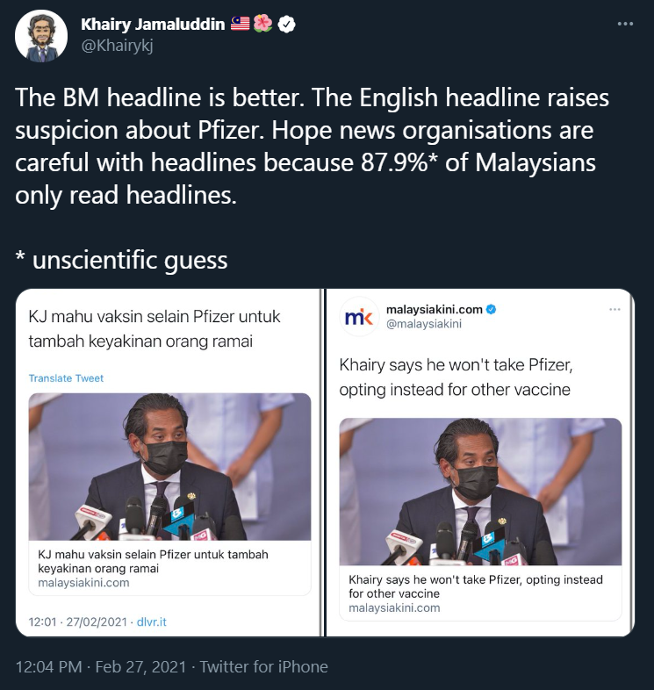
Clickbait headlines

Slide 7

Identifying topic
Each paragraph contains a topic.
Identifying the topic sets the stage for further, in-depth comprehension of a reading text.
The title of a passage, the various prints (e.g. boldface, italics, etc.) and any recurring words are some indicators in determining the topic.
Can you identify the topic of the following paragraphs?

Slide 8
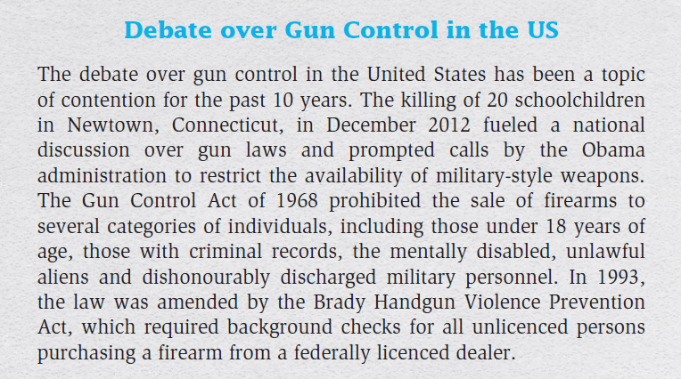
Paragraph with a title

Slide 9
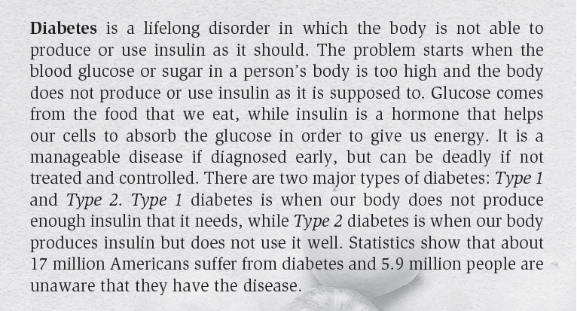
Paragraph with various prints

Slide 10

Paragraph with recurring words

Slide 11
Stated vs Implied Main Idea
Stated Main Idea
The point the author made is clearly identifiable in a sentence
Also known as the topic sentence. Topic sentences are usually in the first sentence of the paragraph, but not always. They may also be located within the paragraph or at the end of the paragraph. They may even appear twice – at the beginning and at the end.
Implied Main Idea
Not clearly or directly stated anywhere in the paragraph
Sometimes a selection lacks a topic sentence but that does not mean that it lacks a main idea. The author simply lets the details of the selection suggest the main idea.
You must figure out the implied idea by deciding the points of all the details.

Slide 12
IDENTIFY THE TOPIC SENTENCE/ STAtED MAIN IDEA
We are on our way to becoming a cashless, checkless society, a trend that began with the credit card. Now some banks are offering “debit cards” instead of credit cards. The costs of purchases made with these cards are deducted from the holder’s bank account instead of being added to the monthly bill. And checking accounts, which are mainly used for paying bills, are going electronic. Now some people can make computer transactions over their pushbutton phones to pay bills by transferring money from their account to the account of whomever they owe. Soon, we may be able to conduct most of our business without signing a check or actually seeing the money we earn and spend.

Slide 13
IDENTIFY THE TOPIC SENTENCE/ STATED MAIN IDEA
The physical complaints of neurotics – people who are overly anxious, pessimistic, hostile, or tense – were once largely ignored by physician. Many doctors believed that the frequent complaint of neurotic were exaggerations. However, new research shows that neurotics are, fact, more likely to have physical problems. Specifically, researchers found neurotics stand a greater chance of having five particular ailments: arthritis, asthma, ulcers, headaches, and heart disease. In addition, there is evidence that people who are pessimistic in their teens and twenties are more likely to become ill or die in their forties.

Slide 14
IDENTIFY THE TOPIC SENTENCE/ STAtED MAIN IDEA
A study at one prison show that owning a pet can change a hardened prison inmate into a more caring person. Another study discovered that senior citizens, both those living alone and those in nursing homes, became more interested in life when they were given pets to care for. Even emotionally disturbed children have been observed to smile and react with interest if there is a cuddly kitten or puppy to hold. Animals, then, can be a means of therapy for many kinds of individuals.

Slide 15

Identifying Implied Main Idea
The implied main idea is not clearly or directly stated in any one sentence in a paragraph. As discussed earlier, it is only suggested or inferred by the author.
Since the readers have to formulate the implied main idea, re-reading and summarising the gist of the paragraph are both helpful at this stage of the process.
Furthermore, the implied main idea must be written in a single sentence and should only contain the author’s most significant point.

Slide 16
What is the implied main idea of this paragraph?
In ancient times, irrational behavior was considered the result of demons and evil spirits taking possession of a person. Later, Greeks looked upon irrational behavior as a physical problem – caused by an imbalance of body fluids called “humors” – or by displacement of an organ. In the highly superstitious Middle Ages, the theory of possession by demons was revived. It reached a high point again in the witch-hunts of eighteenth-century Europe and America. Only in the last one hundred years did true medical explanations gain wide acceptance and were categories of illnesses changed.

Slide 17
What is the implied main idea of this paragraph?

Slide 18

Real-world Connection
Everyday
You come across news everyday and to be able to comment on an issue, you need to be able to identify the main idea. It can also reduce the spread of fake news.
Academic
You are reading a section of your textbook and you try to find a definition of certain terms.
Workplace
You need to read workplace reports and identify the exact intention of the report so you won’t misunderstand.

